Slide 1
Rationale
Aspiring Database Developers should be able to efficiently query and maintain databases.
This module will help students learn the Structured Query Language (SQL) to query and manage databases.

Slide 2
Objectives
In this session, you will learn to:
  Appreciate SQL Server 2005 as a database server

Slide 3
Introduction to SQL Server 2005
SQL Server 2005:
  Is a data engine introduced by Microsoft.
  Provides an environment used to create databases.
  Allows secure and efficient storage and management of data.
  Provides other components and services that support the business intelligence platform to generate reports and help in data analysis.
Notes:
Student already have learnt about type 2 SCDs in Module I. Therefore, you can start this topic by asking the following questions to students:
What are type 2 SCDs?
Given an example to explain type 2 SCDs.
This will recapitulate what they have learnt about type 2 SCD in Module 1.
Now explain the strategy to update the data into these dimension tables with help the example given in SG.
After explaining the examples, you can ask students to think of an example of a type 2 SCD and then tell the strategy to update the data into this dimension table.

Slide 4
Role of a Database Server
  A business application can have the following elements:
  The user interface or the presentation element, through which data is entered.
  The application logic or the business rule element, which helps in validating the entered data.
  The data storage or the data management element, which manages the storage and retrieval of data.
Notes:
You can summarize the session by running through the summary given in SG.
In addition, you can also ask students summarize what they have learnt in this session.

Slide 5
Role of a Database Server (Contd.)
  Based on preceding three elements, the application architectures can be categorized as:
  Single-tier architecture
  Two-tier architecture
  Three-tier architecture
  N-tier architecture
Notes:
You can summarize the session by running through the summary given in SG.
In addition, you can also ask students summarize what they have learnt in this session.

Slide 6
Role of a Database Server (Contd.)
Single-tier architecture:
  Combines all the elements of a business application as a single process.
  Two-tier architecture:
  Divides the business application into two parts, one part handles the data, while the other provides the user interface.
  Is also called the client-server architecture.
Notes:
Student already have learnt about type 2 SCDs in Module I. Therefore, you can start this topic by asking the following questions to students:
What are type 2 SCDs?
Given an example to explain type 2 SCDs.
This will recapitulate what they have learnt about type 2 SCD in Module 1.
Now explain the strategy to update the data into these dimension tables with help the example given in SG.
After explaining the examples, you can ask students to think of an example of a type 2 SCD and then tell the strategy to update the data into this dimension table.

Slide 7
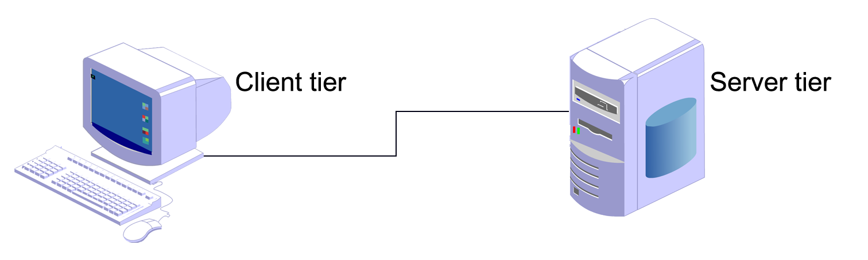
Role of a Database Server (Contd.)
The following figure shows the two-tier architecture.
Handles the UI
Implements the application logic and validates the input data based on the business rules
Notes:
Student already have learnt about type 2 SCDs in Module I. Therefore, you can start this topic by asking the following questions to students:
What are type 2 SCDs?
Given an example to explain type 2 SCDs.
This will recapitulate what they have learnt about type 2 SCD in Module 1.
Now explain the strategy to update the data into these dimension tables with help the example given in SG.
After explaining the examples, you can ask students to think of an example of a type 2 SCD and then tell the strategy to update the data into this dimension table.

Slide 8
Role of a Database Server (Contd.)
Three-tier architecture:
  It divides the business application into three tiers.
  The first tier is called the client tier.
  The second or middle tier is called the business tier.
  The third tier is called the server tier.
Notes:
Student already have learnt about type 2 SCDs in Module I. Therefore, you can start this topic by asking the following questions to students:
What are type 2 SCDs?
Given an example to explain type 2 SCDs.
This will recapitulate what they have learnt about type 2 SCD in Module 1.
Now explain the strategy to update the data into these dimension tables with help the example given in SG.
After explaining the examples, you can ask students to think of an example of a type 2 SCD and then tell the strategy to update the data into this dimension table.

Slide 9
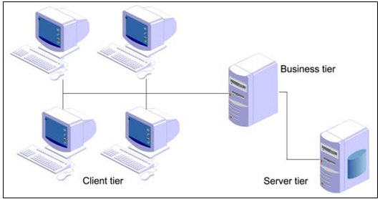
Role of a Database Server (Contd.)
The following figure shows the three-tier architecture.
The business tier consists of all the business rules.
The server tier contains a database server that manages the data.
Notes:
Student already have learnt about type 2 SCDs in Module I. Therefore, you can start this topic by asking the following questions to students:
What are type 2 SCDs?
Given an example to explain type 2 SCDs.
This will recapitulate what they have learnt about type 2 SCD in Module 1.
Now explain the strategy to update the data into these dimension tables with help the example given in SG.
After explaining the examples, you can ask students to think of an example of a type 2 SCD and then tell the strategy to update the data into this dimension table.

Slide 10
Role of a Database Server (Contd.)
N-tier architecture:
  Is also called as multi-tier architecture.
  Has one component near the client tier, which is responsible to do the client side validation and send the data to the presentation tier.
Notes:
Student already have learnt about type 2 SCDs in Module I. Therefore, you can start this topic by asking the following questions to students:
What are type 2 SCDs?
Given an example to explain type 2 SCDs.
This will recapitulate what they have learnt about type 2 SCD in Module 1.
Now explain the strategy to update the data into these dimension tables with help the example given in SG.
After explaining the examples, you can ask students to think of an example of a type 2 SCD and then tell the strategy to update the data into this dimension table.

Slide 11
Role of a Database Server (Contd.)
The n-tier architecture consists of the following layers:
  Client tier
  UI-centric processing components
  Data-centric processing objects
  Database server
Notes:
Student already have learnt about type 2 SCDs in Module I. Therefore, you can start this topic by asking the following questions to students:
What are type 2 SCDs?
Given an example to explain type 2 SCDs.
This will recapitulate what they have learnt about type 2 SCD in Module 1.
Now explain the strategy to update the data into these dimension tables with help the example given in SG.
After explaining the examples, you can ask students to think of an example of a type 2 SCD and then tell the strategy to update the data into this dimension table.

Slide 12
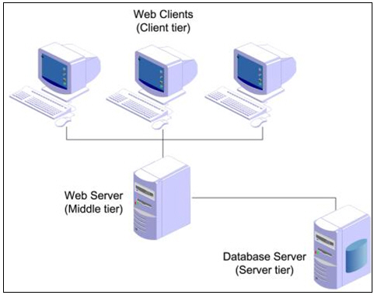
Role of a Database Server (Contd.)
  The following figure shows how the Web applications follow multi-tier architecture.
The clients make requests to and receive responses from the Web server.
The Web server transfers the request for data to a database server.
Notes:
Student already have learnt about type 2 SCDs in Module I. Therefore, you can start this topic by asking the following questions to students:
What are type 2 SCDs?
Given an example to explain type 2 SCDs.
This will recapitulate what they have learnt about type 2 SCD in Module 1.
Now explain the strategy to update the data into these dimension tables with help the example given in SG.
After explaining the examples, you can ask students to think of an example of a type 2 SCD and then tell the strategy to update the data into this dimension table.

Slide 13

SQL Server 2005 Components
What are the components of SQL Server 2005?

Slide 14
SQL Server 2005 Components (Contd.)
The following figure displays the components of SQL Server 2005.
  Database Engine
  Service Broker
  Replication
  Full-Text Search
  Notification Services
  Integration Services
  Analysis Services
  Reporting Services
Notes:
Explain the components of SQL Server as follows:
Database Engine: Provides support to store, query, process, and secure data on the database server
Integration Services: Allow you to gather and integrate data from various disparate data sources available in an organization
Analysis Services: Help in data analysis in a business intelligence application
Reporting Services: Provide support to generate comprehensive reports on data in database engine or in data warehouse

Slide 15
SQL Server 2005 Components (Contd.)
Database engine:
  Provides support to store, query, process, and secure data on the database server.
  Allows you to create and manage database objects, such as tables.
  Provides the following background services:
    Service Broker
    Replication
    Full-text search
    Notification services
Notes:
Student already have learnt about type 2 SCDs in Module I. Therefore, you can start this topic by asking the following questions to students:
What are type 2 SCDs?
Given an example to explain type 2 SCDs.
This will recapitulate what they have learnt about type 2 SCD in Module 1.
Now explain the strategy to update the data into these dimension tables with help the example given in SG.
After explaining the examples, you can ask students to think of an example of a type 2 SCD and then tell the strategy to update the data into this dimension table.

Slide 16
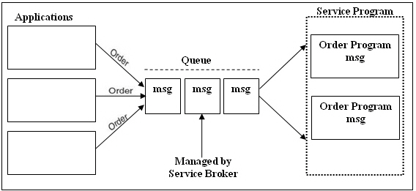
SQL Server 2005 Components (Contd.)
  Service Broker:
    Provides support for asynchronous communication between clients and the database server.
    Enables reliable query processing.
  The following figure shows an example of order processing system.
Notes:
Student already have learnt about type 2 SCDs in Module I. Therefore, you can start this topic by asking the following questions to students:
What are type 2 SCDs?
Given an example to explain type 2 SCDs.
This will recapitulate what they have learnt about type 2 SCD in Module 1.
Now explain the strategy to update the data into these dimension tables with help the example given in SG.
After explaining the examples, you can ask students to think of an example of a type 2 SCD and then tell the strategy to update the data into this dimension table.

Slide 17
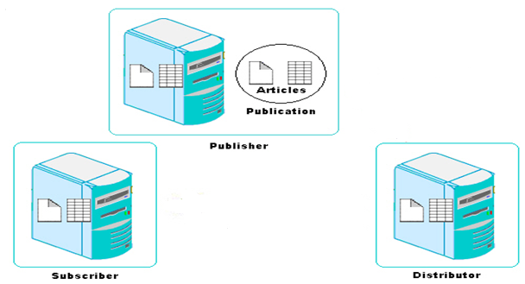
SQL Server 2005 Components (Contd.)
  Replication:
    Allows you to copy and distribute data and database objects from one database server to another.
  The following figure shows an example of order processing system.
Copies data to the distributor
Distributes data to the Subscriber
Notes:
Student already have learnt about type 2 SCDs in Module I. Therefore, you can start this topic by asking the following questions to students:
What are type 2 SCDs?
Given an example to explain type 2 SCDs.
This will recapitulate what they have learnt about type 2 SCD in Module 1.
Now explain the strategy to update the data into these dimension tables with help the example given in SG.
After explaining the examples, you can ask students to think of an example of a type 2 SCD and then tell the strategy to update the data into this dimension table.

Slide 18
SQL Server 2005 Components (Contd.)
  Full-text search:
    Allows you to implement fast and intelligent search in large databases.
  Notification services:
    Allow you to generate and send notification messages to the users or administrators about any event.
    Allow developers to build notification applications that send timely, personalized information updates, helping to enhance customer relationships.
Notes:
Student already have learnt about type 2 SCDs in Module I. Therefore, you can start this topic by asking the following questions to students:
What are type 2 SCDs?
Given an example to explain type 2 SCDs.
This will recapitulate what they have learnt about type 2 SCD in Module 1.
Now explain the strategy to update the data into these dimension tables with help the example given in SG.
After explaining the examples, you can ask students to think of an example of a type 2 SCD and then tell the strategy to update the data into this dimension table.

Slide 19
SQL Server 2005 Components (Contd.)
Integration services:
  These services allow you to gather and integrate the varied data in a consistent format in a common database called the data warehouse.
  A data warehouse is similar to a physical warehouse that stores raw material or products for further distribution.
  The SQL Server 2005 Integration Services (SSIS) Import and Export Wizard helps you to complete the process of selecting the data source, the destination, and the objects that will be transferred to create a data warehouse.
Notes:
Student already have learnt about type 2 SCDs in Module I. Therefore, you can start this topic by asking the following questions to students:
What are type 2 SCDs?
Given an example to explain type 2 SCDs.
This will recapitulate what they have learnt about type 2 SCD in Module 1.
Now explain the strategy to update the data into these dimension tables with help the example given in SG.
After explaining the examples, you can ask students to think of an example of a type 2 SCD and then tell the strategy to update the data into this dimension table.

Slide 20
SQL Server 2005 Components (Contd.)
Analysis services:
  These services help in data analysis in a BI application.
  Microsoft SQL Server 2005 Analysis Services (SSAS):
    Provides online analytical processing (OLAP) for BI applications.
Notes:
Student already have learnt about type 2 SCDs in Module I. Therefore, you can start this topic by asking the following questions to students:
What are type 2 SCDs?
Given an example to explain type 2 SCDs.
This will recapitulate what they have learnt about type 2 SCD in Module 1.
Now explain the strategy to update the data into these dimension tables with help the example given in SG.
After explaining the examples, you can ask students to think of an example of a type 2 SCD and then tell the strategy to update the data into this dimension table.

Slide 21
SQL Server 2005 Components (Contd.)
Reporting services :
  These services provide support to generate complete reports on data in the database engine or in the data warehouse.
  These services provide secure and restricted access to these reports.
  Microsoft SQL Server 2005 Reporting Services (SSRS):
    Helps in creating Web-based reports that is based on the content stored in a variety of data sources.
Notes:
Student already have learnt about type 2 SCDs in Module I. Therefore, you can start this topic by asking the following questions to students:
What are type 2 SCDs?
Given an example to explain type 2 SCDs.
This will recapitulate what they have learnt about type 2 SCD in Module 1.
Now explain the strategy to update the data into these dimension tables with help the example given in SG.
After explaining the examples, you can ask students to think of an example of a type 2 SCD and then tell the strategy to update the data into this dimension table.

Slide 22
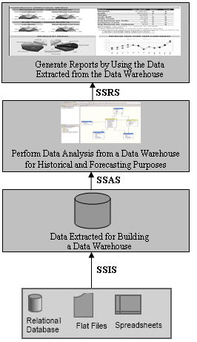
SQL Server 2005 Components (Contd.)
The following figure shows the usage of the various SQL Server core components in a BI application.
Notes:
Student already have learnt about type 2 SCDs in Module I. Therefore, you can start this topic by asking the following questions to students:
What are type 2 SCDs?
Given an example to explain type 2 SCDs.
This will recapitulate what they have learnt about type 2 SCD in Module 1.
Now explain the strategy to update the data into these dimension tables with help the example given in SG.
After explaining the examples, you can ask students to think of an example of a type 2 SCD and then tell the strategy to update the data into this dimension table.

Slide 23

SQL Server Integration with the .NET Framework
As against the earlier versions of SQL Server, Microsoft SQL Server 2005 is integrated with the .NET Framework.
Notes:
Student already have learnt about type 2 SCDs in Module I. Therefore, you can start this topic by asking the following questions to students:
What are type 2 SCDs?
Given an example to explain type 2 SCDs.
This will recapitulate what they have learnt about type 2 SCD in Module 1.
Now explain the strategy to update the data into these dimension tables with help the example given in SG.
After explaining the examples, you can ask students to think of an example of a type 2 SCD and then tell the strategy to update the data into this dimension table.

Slide 24
SQL Server Integration with the .NET Framework (Contd.)
  The following figure shows the integration of SQL Server 2005 with the .NET Framework.
.NET Framework
  Database Engine
  Service Broker
  Replication
  Full-Text Search
  Notification Services
  Integration Services
  Analysis Services
  Reporting Services
Notes:
You can summarize the session by running through the summary given in SG.
In addition, you can also ask students summarize what they have learnt in this session.

Slide 25
SQL Server Integration with the .NET Framework (Contd.)
  The .NET Framework:
  Is an environment used to build, deploy, and run business applications.
  Has its own collection of services and classes.
  Consists of the following components:
    Development tools and languages
    Base class library
    Common Language Runtime (CLR)
Notes:
You can summarize the session by running through the summary given in SG.
In addition, you can also ask students summarize what they have learnt in this session.

Slide 26
SQL Server Integration with the .NET Framework (Contd.)
  Development tools and languages:
    Are used to create the interface for the Windows forms, Web forms, and console applications.
  Base class library:
    Provides classes that can be used in the code to accomplish a range of common programming tasks, such as:
      String management
      Data collection
      Database connectivity
      File access
Notes:
You can summarize the session by running through the summary given in SG.
In addition, you can also ask students summarize what they have learnt in this session.

Slide 27
SQL Server Integration with the .NET Framework (Contd.)
  CLR:
    Provides an environment for the application to run.
    Provides the following features:
      Automatic memory management
      Standard type system
      Language interoperability
      Platform independence
      Security management
Notes:
You can summarize the session by running through the summary given in SG.
In addition, you can also ask students summarize what they have learnt in this session.

Slide 28
Summary
In this session, you learned that:
  A business application can have three elements: user interface, business logic, and data storage.
  A database server is used to store and manage the database in a business application.
  SQL Server 2005 consists of the four core components: database engine, integration services, analysis services, and reporting services.
  The database engine provides support to store, query, process, and secure data on the database server.
  Integration services allow you to gather and integrate this varied data in a consistent format in a common database called the data warehouse.
Notes:
You can summarize the session by running through the summary given in SG.
In addition, you can also ask students summarize what they have learnt in this session.

Slide 29
Summary (Contd.)
  Analysis services assist in determining past trends and formulating future business decisions.
  Reporting services provide support to generate comprehensive reports on the data stored in the database engine or the data warehouse.
  The .NET Framework is an environment used to build, deploy, and run business applications through various programming languages.
  The .NET Framework consists of three components: development tools and languages, base class library, and CLR.
Notes:
You can summarize the session by running through the summary given in SG.
In addition, you can also ask students summarize what they have learnt in this session.

